Slide 1
Book3
File created on: 5/14/2023 3:08:29 PM

Slide 2
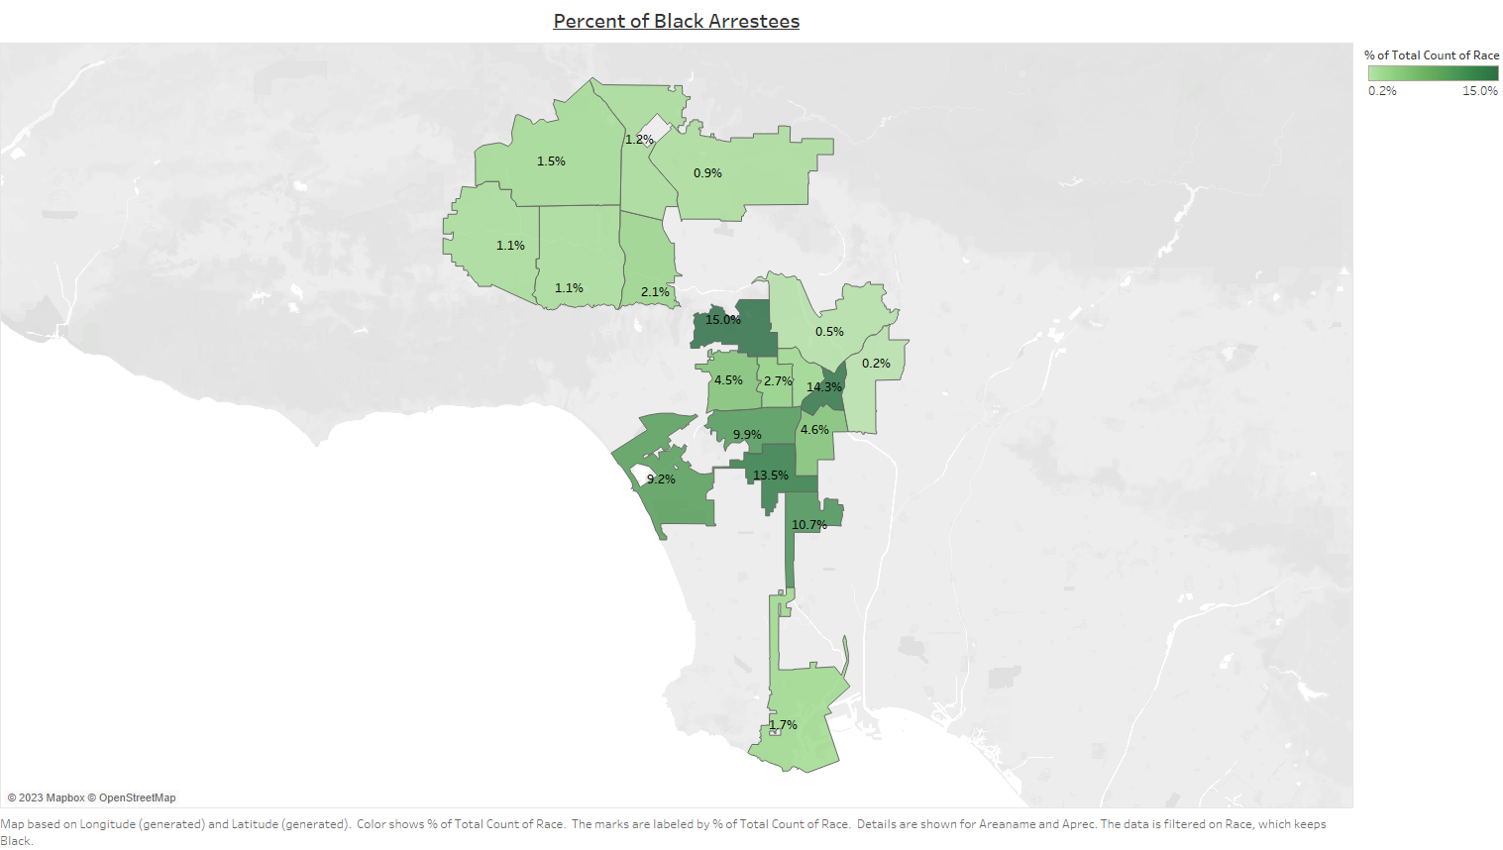

Slide 3
